Slide 1
Coursera Capstone Project
Karthik Challa

Slide 2
Neighborhood Recommendation
Business Problem:
Identifying the best location for a new Apartment Complex based on walking scores.
Problem Description and Stakeholders:
A real estate company based in the United States, is thinking about expanding their business to Canada.
This company is known for affordable high rise’s located in areas with high walking scores.
A good walking score essentially means that the Apartment is in walking distance to a lot of amenities like restaurant’s, public transportation, super markets, parts etc.
Since it’s the first time they are entering Canadian market, they decided to pick Toronto as their first hub.
In this project, I worked with FourSuare API’s and the neighborhoods in Toronto, to come up with recommendations on the best locations for an apartment complex.

Slide 3
Parsed Dataset containing the Postal Codes and Neighborhood Info:
 | PostalCode | Borough | Neighborhood
2 | M3A | North York | Parkwoods
3 | M4A | North York | Victoria Village
4 | M5A | Downtown Toronto | Harbourfront
5 | M5A | Downtown Toronto | Regent Park
6 | M6A | North York | Lawrence Heights

Slide 4
Geolocation Data added to the Dataset
 | PostalCode | Borough | Neighborhood | Latitude | Longitude
0 | M1B | Scarborough | Rouge, Malvern | 43.806686 | -79.194353
1 | M1C | Scarborough | Highland Creek, Rouge Hill, Port Union | 43.784535 | -79.160497
2 | M1E | Scarborough | Guildwood, Morningside, West Hill | 43.763573 | -79.188711
3 | M1G | Scarborough | Woburn | 43.770992 | -79.216917
4 | M1H | Scarborough | Cedarbrae | 43.773136 | -79.239476

Slide 5
Processed Dataset used for Evaluation containing only Borough’s in Toronto:
 | PostalCode | Borough | Neighborhood | Latitude | Longitude
37 | M4E | East Toronto | The Beaches | 43.676357 | -79.293031
41 | M4K | East Toronto | The Danforth West, Riverdale | 43.679557 | -79.352188
42 | M4L | East Toronto | The Beaches West, India Bazaar | 43.668999 | -79.315572
43 | M4M | East Toronto | Studio District | 43.659526 | -79.340923
44 | M4N | Central Toronto | Lawrence Park | 43.728020 | -79.388790

Slide 6
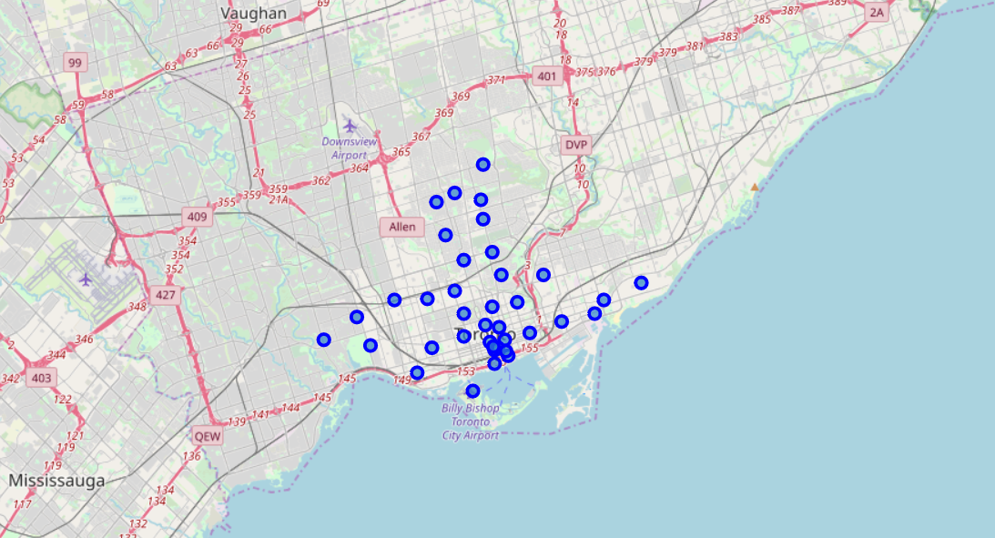
Map of Toronto using Folium to visualize the neighborhoods:

Slide 7
FourSquare API’s to get Venue Details:
 | Neighborhood | Neighborhood Latitude | Neighborhood Longitude | Venue | Venue Latitude | Venue Longitude | Venue Category
0 | The Beaches | 43.676357 | -79.293031 | The Big Carrot Natural Food Market | 43.678879 | -79.297734 | Health Food Store
1 | The Beaches | 43.676357 | -79.293031 | Grover Pub and Grub | 43.679181 | -79.297215 | Pub
2 | The Beaches | 43.676357 | -79.293031 | Starbucks | 43.678798 | -79.298045 | Coffee Shop
3 | The Beaches | 43.676357 | -79.293031 | Glen Manor Ravine | 43.676821 | -79.293942 | Trail
4 | The Beaches | 43.676357 | -79.293031 | Upper Beaches | 43.680563 | -79.292869 | Neighborhood

Slide 8
Neighborhoods with Most Venues
Davisville 30
Studio District 30
St. James Town 30
Central Bay Street 30
Chinatown, Grange Park, Kensington Market 30
Adelaide, King, Richmond 30
Harbourfront, Regent Park 30
Design Exchange, Toronto Dominion Centre 30
Stn A PO Boxes 25 The Esplanade 30
Cabbagetown, St. James Town 30

Slide 9
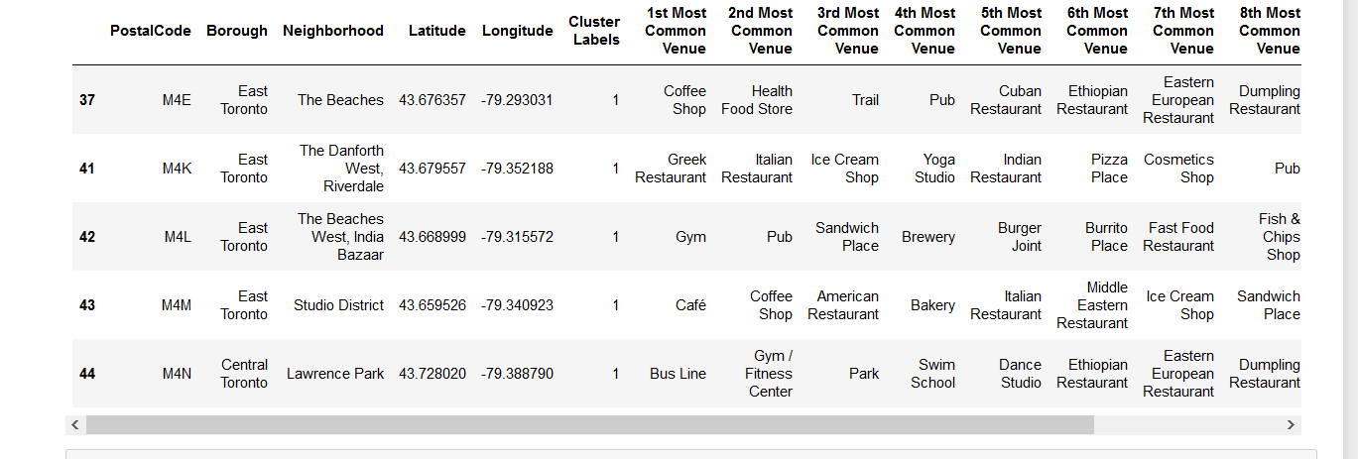
Top Venues for Each Borough

Slide 10
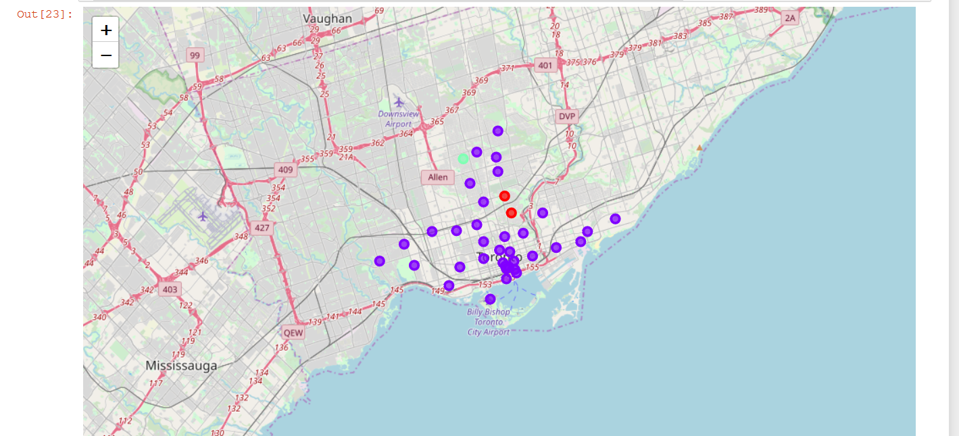
Visualizing the Clusters

Slide 11
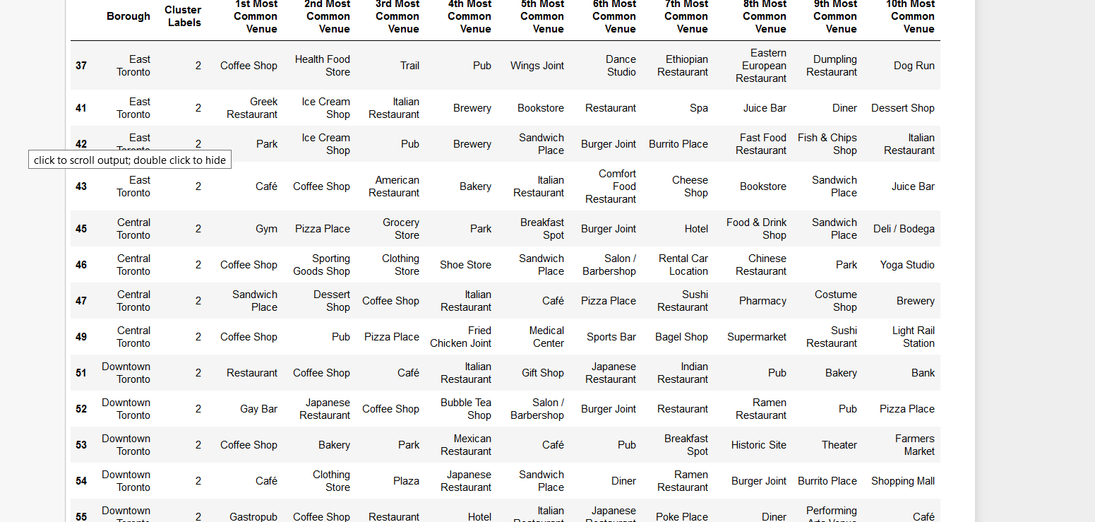
Exploring the Clusters:

Slide 12
Results: Best venues suited for an apartment complex
Café’s
Grocery Store’s.
Hiking Trails/Parks
Fitness Clubs.
Restaurants.

Slide 13
Results: Recommendations for Neighborhoods:
The Danforth West, Riverdale
Studio District
Commerce Court, Victoria Hotel
Business Reply Mail Processing Centre 969 Eastern
Harbourfront, Regent Park

